Slide 1
choreography in lockdown Lesson 1
Creating a site specific dance for the camera

Slide 2
What makes a good piece of choreography?
What pieces of choreography have you seen or been involved in that you liked? Why did you think they were effective? What was it you thought worked well?
Was the dance idea/stimulus creative or inspirational?
How were the movements (actions) interesting and varied?
How was the space used effectively?
How did the movements show different qualities (dynamics)?
How did the dancers relate to each other, the audience, the location, or the camera?
Did the dance have a clear structure, beginning, middle and end?
How was the music effectively used?
Did all of the above relate to the dance idea/theme?
Were you inspired to move/create/think/feel? How? Why?

Slide 3
Choosing a stimulus – a location – a site! (A stimulus is a starting point – something that inspires you to create)
Create a Mind Map of a variety of sites you could choose?
Could you easily and safely dance in the site? Could you film there? Ask a parent to access the risks with you.
Look out for different stimuli in the site, what can you see, hear, feel, taste and smell?
Can you translate these senses into movement ideas, expressions, themes?
Is there any props you could use? Would you use these as part of the dance/choreography or as part of the setting?
Try improvising in the space to get a physical feeling and perception of it.
Take photos/get measurements of the site to get an idea of how it looks on camera and so you can practice at home.

Slide 4
Motifs
What are motifs?
A movement or phrase of movement that embodies the style and content of a dance idea.
Why are they important?
They are like the ingredients of the dance to give flavour and meaning.
They communicate to the audience the meaning/theme.
Think of a song where words/phrases get repeated and developed – these are motifs which help to convey meaning.
Can you identify motifs in the dances you’ve watched?
Using your site and your dance idea create a dance motif.

Slide 5
Motif development
We can develop motifs to create more movement material within the same dance idea by…
Adding actions (moves) to the phrase. E.g. jump, roll, fall, turn, travel, stillness, balance, gesture.
Playing with the space used. E.g. the level, shape, size, direction, design
Playing with dynamics. E.g. the speed, weight, energy, flow, accent
Using different body parts
Changing the order of the movements. Repeat, add or take away
Choosing the most appropriate ideas in relation to the site/theme.

Slide 6
Choreographic devices / structures
Repetition
Contrasts
Transitions
Highlights, Climax
Beginning, middle, end
Structures eg Binary – AB; Ternary – ABA; Rondo – verses different and chorus the same; Narrative/Episodic

Slide 7
choreography in lockdown Lesson 2
Creating a site specific dance for the camera

Slide 8
Relationship with: site / prop / camera / audience
How are you going to use the location?
Would you use props literally or abstractly?
What are you trying to communicate to the audience? Will they just spectate or will you interact with them?
Would the camera be fixed or follow you?

Slide 9
Creating movement from your site

Slide 10
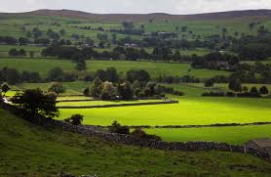
Creating movement from your site

Slide 11
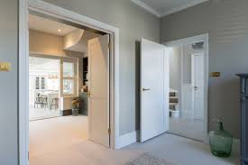
Creating movement from your site

Slide 12
Examples of work
'Chandelier' by Sia - https://youtu.be/2vjPBrBU-T
'Memory Lane’ accessed by Dex Lee’s public facebook page
https://www.facebook.com/DexLeeActor/videos/677783753077513/?extid=vt6GTYKhzProPsPo
U Dance Digital 2020
Maya Darren https://www.youtube.com/watch?v=OnUEr_gNzwk
Within her eyes https://www.youtube.com/watch?v=FLNxAGDPNVo
Magic carpet https://www.youtube.com/watch?v=1C_40B9m4tI

Slide 13
choreography in lockdown Lesson 3
Creating a site specific dance for the camera

Slide 14
Music
Choose music to enhance your dance idea – will it be integral or background?
Look for contrasts and variations in the music
Maybe try out different accompaniments e.g. spoken word, natural sounds, sound effects, silence, live musicians, percussion etc
Be careful if there are lyrics – they need to be appropriate and related to dance idea
Play with the rhythms of the music
Phrasing is important and needs to be considered
Marry the structure of the dance to that of the music
Make sure the music finishes clearly (a fade out could give the dance a weak ending – unless that is what you intend)
Honour the music, composer and artist!

Slide 15
check list
Find a site to dance in and an idea to develop
Research and plan
Improvise, explore and play with the site and motifs
Choose most effective ideas
Think of ways to develop using choreographic devices
Choose the music and structure the dance
Refine your ideas and performance
Film and revise and re-film if needed
Give yourself a massive pat on the back and if you choose send us your amazing creations! We’d so love to see them!

Slide 16
choreography in lockdown Lesson 4
Creating a site specific dance for the camera

Slide 17
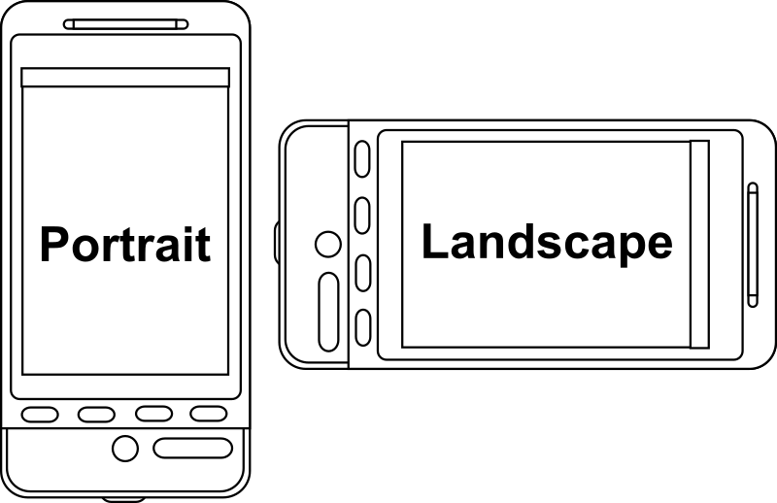
Film orientation
Film in landscape.

Slide 18
Camera use and choices

Slide 20
Lighting
Make sure the light is equal in all directions.
Be carful when lighting from behind or direct light into camera.
Plan the time of day that you will film.

